Slide 1
SENIOR DESIGN 2012
TEXAS CHRISTIAN UNIVERSITY

Slide 2
Project Overview
2010-2011 Senior Project (Healing Touch)
Developed several games on multi-touch devices for medical rehabilitation
Collected game data for subsequent reporting
Initial work with Dr. Malcolm Stewart and Mike Skupien
Laid primary groundwork and contacts
2011-2012 Senior Project (TheraTouch)
Develop suite of activities with input from practicing therapists
Collect activity results
Develop reporting for patient history and comparative studies
Deliver a working system, including the Microsoft Surface, to the Physical Medicine & Rehabilitation Department - HEB

Slide 3
Texas Health Resources
Physical Medicine & Rehabilitation Department (Hurst-Euless-Bedford)
Jeanie Parsley – Department Director
Rachel King – Speech Therapist
Rob Robinson – Occupational Therapist
Michelle Luckey – Physical Therapist
Makiko Ogawa – Speech Therapist
Technology
Mike Skupien – Application Architect
Reporting
Dr. Malcolm Stewart – Director of Human Performance Lab

Slide 4
Team Roles
John Farris
Team Website Lead, TheraLink Development
Kevin Lawhon
Activity Development
Mason McGlothlin
Database Development, TheraLink Development
Nipuna Perera
Activity Development
Mandy Seremet
Project Manager, Client Liaison, Prototype Development

Slide 5
Team Roles
Scott Boykin
Technical Lead, TheraTouch Development
Adam Burt
Activity Development, Graphic Design
Cristina Cline
Project Manager, Activity Development
Jeff Gettel
Database Development, TheraLink Development
Andrew Hughes
Activity Development
Joey Wilkinson
Team Website Lead, TheraLink Development, Prototype Development

Slide 6
Development Environment
TheraTouch Framework
Microsoft Surface Unit (Version 1.1) with 32 bit Windows Vista
Microsoft Surface SDK 1.0 SP1
XNA Game Studio 3.1
Visual Studio 2008
Database Framework
Microsoft SQL Server 2008 R2
TheraLink Framework
Microsoft IIS 6.0
Microsoft .NET Framework 4.0
Visual Studio 2010

Slide 7
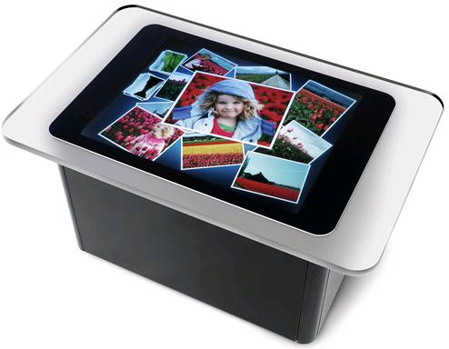
Microsoft Surface
Originally released in 2007
Multi-user, multi-touch social interaction device
Uses IR cameras to sense touches
Capable of having 50+ active touch points
“Domino Tag” initiates
digital response for object
recognition

Slide 8
System Architecture

Slide 9
System Overview
TheraLink (Web-based Application)
User Management
Session Management
View Reports
TheraTouch (Microsoft Surface Application)
Free-Play
Session Mode
Database
Stores Non-Sensitive Patient Data
Stores Session Information
Activity Options
Activity Order
Stores Recorded Information
Activity Results

Slide 10
TheraLink
Login Roles for Clinician Staff
Office Staff, Therapist, Administrator
User Management
Saves Non-Sensitive Patient Information
Print Tag for Microsoft Surface Recognition
Session Management
Add Activities & Edit Options
View Reports
Display Results
View Trends

Slide 11
TheraTouch
FreePlay
Openly Play Activities
No Information Recorded/Stored
Session Mode
Open Session by Placing Tag on Microsoft Surface
Launch Activities Pre-Defined for Session
Activity Results Recorded on Completion
Activities Lock After Completed

Slide 12
Activities

Slide 13
Alternate Trail Making
Options
Number of distinct shapes (2-6)
Total number of shapes (2-20)
Object type (shapes, letters, numbers)
Information Recorded
Time elapsed
Correct/incorrect selections
Description
User must select objects in order from smallest to largest while following a pattern (i.e. small circle > small triangle > medium circle > medium triangle > large circle > large triangle…). Activity is complete when all objects have been selected.

Slide 14
Seek Shape
Options
Number of distinct shapes (2-6)
Total number of shapes (6-20)
Object type (shapes, letters, numbers)
Information Recorded
Time elapsed
Correct/incorrect selections
Description
An initial shape is displayed. On the following screen, user must identify and select all instances of that original shape. Activity is complete when all instances are found.

Slide 15
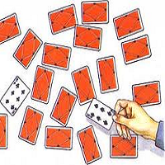
Card Match
Options
Difficulty (2X2, 4X4, 6X6)
Shape theme (fruits, shapes, dogs)
Timer enabled (true, false)
Information Recorded
Time elapsed
Number of tries
Description
User must find matching image pairs by selecting cards within grid displayed. If a match is found, cards will disappear. Activity is complete when all matches have been found.

Slide 16
Odd One Out
Options
Number of distinct shapes (4-8)
Number of rounds (1-10)
Timer enabled (true, false)
Information Recorded
Time elapsed
Total selections
Incorrect selections
Description
User must choose the object that does not belong in the list of displayed objects. Activity is complete when all rounds have been finished.

Slide 17
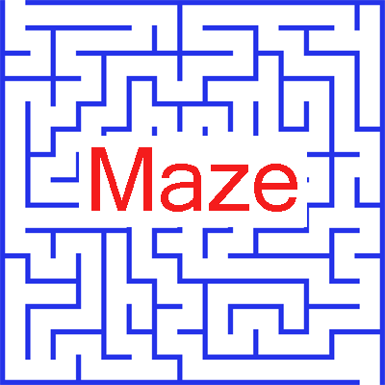
Maze
Options
Difficulty (Easy, Medium, Hard)
Information Recorded
Time elapsed
Number of walls hit
Description
User must draw path from start to finish while remaining inside the walls/barriers of the maze. Activity is complete when correct path has been found.

Slide 18
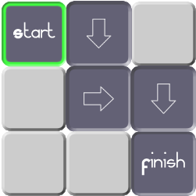
Path Track
Options
Grid size (4X4, 5X5, 6X6)
Number of turns (0-5+)
Number of rounds (4-8)
Length of pattern (4-7+)
Information Recorded
Correct/incorrect selections
Time Elapsed
Description
A path is displayed on the grid. User must recreate the path on the following blank grid. Activity is complete when all rounds have been finished.

Slide 19
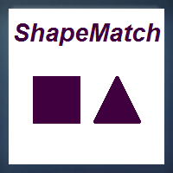
Shape Match
Options
Sequence length (5-25 shapes)
Number of distinct shapes (2-5)
Object type (shapes, letters, numbers)
Information Recorded
Time elapsed
Correct/incorrect matches
Description
User must identify if the previous object displayed matches the current object displayed. Activity is complete when sequence is finished.

Slide 20
Wipe the Table
Options
Color enabled (true, false)
Wipe enabled (true, false)
Spawn area (Min/Max X/Y)
Ordered (true, false)
Information Recorded
Time elapsed
Incorrect hits
Description
A blob is randomly displayed on the screen. User must wipe the blob off of the screen. Activity is complete when all messes have been cleaned up.

Slide 21
Project Timeline
Iteration 1..........(December 13, 2011)
TheraTouch Operational (with Unit Testing)
TheraLink – Application Skeleton, Add User
First Set of Activities Deployed (Check Functionality with Framework, with Unit Testing)
Database Connectivity
Iteration 2..........(January 26, 2012)
Second Set of Activities Deployed (with Unit Testing)
TheraLink – Add/Edit Session (Fully-Functional Minus Reporting, with Unit Testing)
Iteration 3..........(February 21, 2012)
Framework Complete & Finalized
Third Set of Activities Deployed (with Unit Testing)
TheraLink – Reporting (with Unit Testing)
Iteration 4..........(March 22, 2012)
Final Activities Deployed (with Unit Testing)
All Activities Complete & Finalized
Deliver Project to THR for User-Acceptance Testing

Slide 22
Questions?

Slide 23
Demonstration
http://brazos.cs.tcu.edu/TheraLink-app

